Slide 1
RPE Career Day 2013
“Lessons from 3rd Grade”

Slide 2





What is Public Relations?
Grow brands
Create stories
Build Relationships
Notes:
I do Public Relations. What does that mean? We help companies manage their reputation with their external audiences. My job is to persuade the public/you that what the company has to offer is wrothwhiel
Do any of you have parents or relatives that own their own business?
Who knows these brands? Apple” Microsoft? Mind Craft
What’s your favorite brand?
Have any of you written a story? How did you start? Did you think about who you were writing about

Slide 3
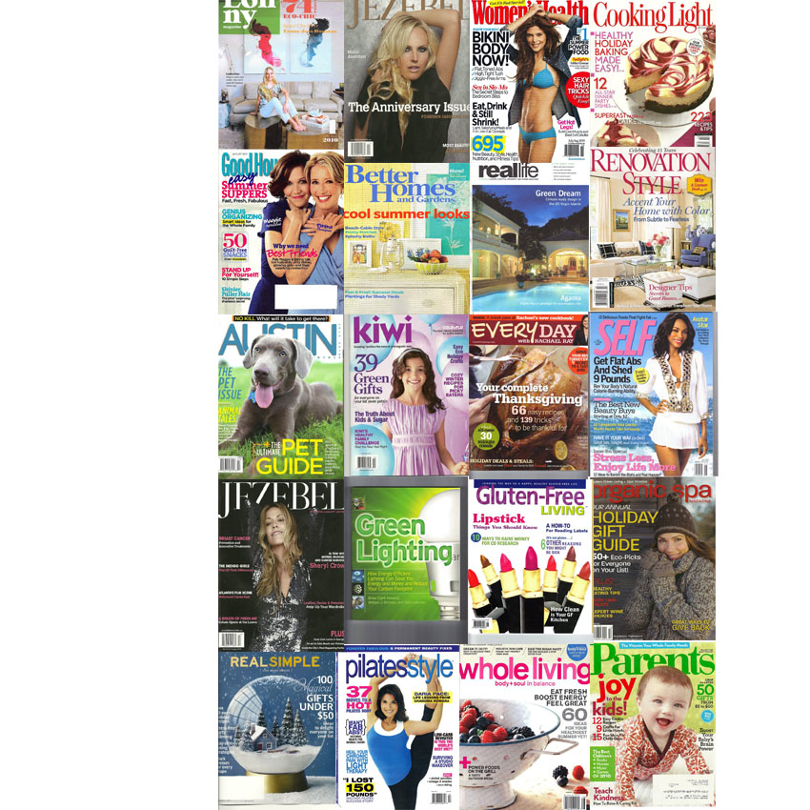
Notes:
Explain what lifestyle PR is. Our expertise is premium lifestyle brands. We only rep companies with products + services that we personally love. Premium is not about price, it’s about quality and fulfilling the customer promise.
But the PR framework and strategies cross all industries and can be applied to all business’

Slide 4
I chose Public Relations because…
Career vs. job
Builder
Writer
Listener
Problem solver
Social
I always wanted to be the boss
Notes:
What is a career? Can anyone tell me? What’s the difference between a career and a job. If you do what you love, that is a career. A job is one thing/a role along your path to building a career.
I chose PR because I like to build things, to create something.
I have lawyas had strong writing skills. This is a skill I use almost every day in my job,
I’ve also developed good listenting skills. This helps me understand what my clients want.
I am a problem solver. When an issue comes up I am good atunderstanding how to create a solution. Can anyone give me an example of their problem solving?
I am also social. I like to work with an to be around people. The interaction with others makes me better.
Last but not least, I always wanted to be the boss. PR has enabled me to take many leadership positions.

Slide 5
Education and Training
  BA in Literature and Language
    Reading
    Writing
    Critical Thinking
    Imagination
  On the Job Training
    Present your best self
    Do great work
    Learn from mistakes
    Move on
    A positive attitude
Notes:
The day of big agency retainers is over. Big agency = bureacracy, hidden filler fees and costs + junior people doing the work.
Two factors at play: Explosion of boutique agencies (KS PR ) / freelancers / social media make it possible to “Look Big” even when you are just a website or single store front.
PR is EARNED. Advertising is PAID.
Oprah show is the single entity that can actually create a company / move needle significantly on your business. (Karen Neuburger example). However, the show is gone after this year and a one time hit is a gift not a sustainable pro-active communications strategy.
I hate the word Spin. PR has to be authentic to be sustainable and credible. Social media / yelp/fb/twitter make it even more imprant for companies to speak plainly and authenitcally.
Do your due diligence FIRST before “going out there” blogging, posting, tweeting. Once it’;s out there, it is impossible to erase. There is always a footprint.

Slide 6
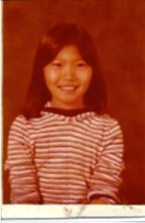
Things I learned in 3rd Grade
To listen
To ask questions
It’s ok to make mistakes
Be a good friend
Notes:
I met my best friend in Mrs. Freemans 3rd grade class.
Do any of you have a best friend?

Slide 7
“If I knew then, what I know now”
(Important Career Skills for 3rd Graders)
Grammar + Spelling
Reading + Analytics
Creativity + Building
Relationships + Reputation
Find a role model

Slide 8
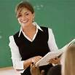
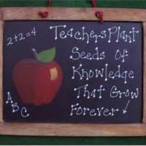
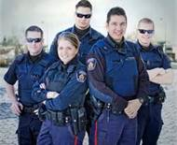
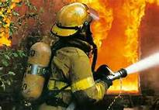
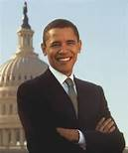


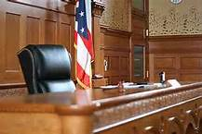
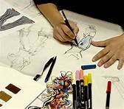
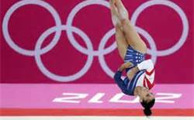

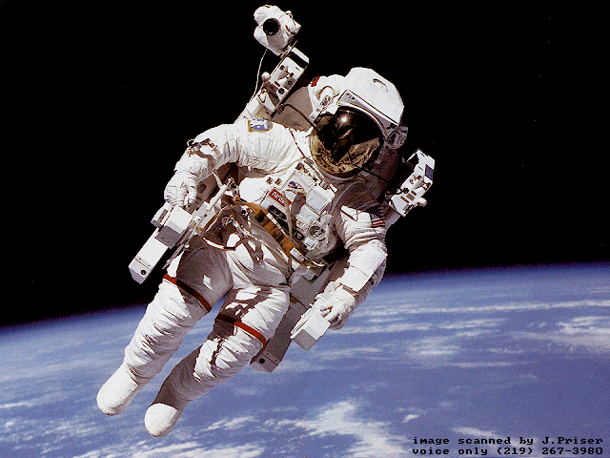
Anything you imagine can be.

Slide 9
You are the future.
Doesn’t just happen.
You have to make it happen.
You are all amazing.
Have fun.
Believe in yourself.

Slide 10
Thank you!

